Slide 1
Drawing with Nested Loops and Break
CS 142
David Anderson
Slides by Martin Hock

Slide 2
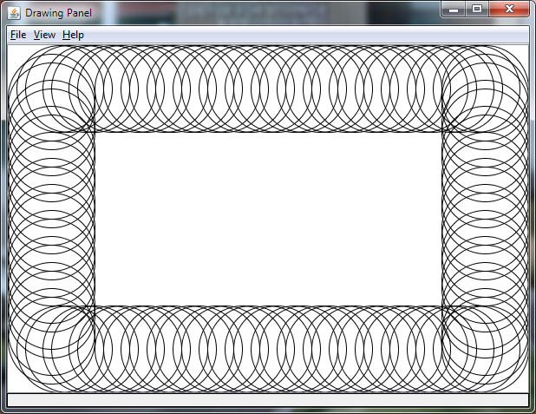
Review: Skipping drawing some circles
What if we’d like to only draw some of the circles?
Let’s draw two circles, skip one, draw two, skip one, etc…

Slide 3
Using the continue statement to skip circles
We can check to see if the current x or y value is divisible by 3
Use the divisibility code we came up with for primality testing
x or y takes on successive multiples of 10
for (int y = 0; y + 100 <= height; y += 10) {
if (y / 3 * 3 == y) continue; // skip drawing this y
// draw the left oval
g.drawOval(0, y, 100, 100);
// draw the right oval
g.drawOval(width - 100, y, 100, 100);
}

Slide 4
Nested loops
We have seen constructs inside of each other
For example, all of the code we have written has been inside a main method
We have included if statements inside of a loop
Now we will see that you can put a loop inside a loop!

Slide 5
What are nested loops for?
A loop inside a loop lets us vary two parameters at once
Example: Working with a two dimensional space like the screen
Example: Two parameters that vary mathematically

Slide 6
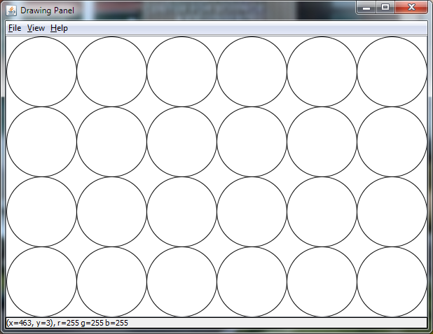
Example: A window full of circles
Let’s fill the window with circles!
We’ll draw them on an evenly spaced grid
We’ll space them so that each one touches on the edges

Slide 7
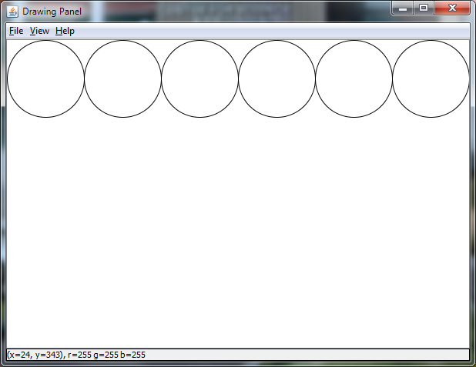
Review: Start by spacing out the circles
for (int x = 0; x + 100 <= width; x = x + 100) { g.drawOval(x, 0, 100, 100); }

Slide 8
Now, put the loop inside a loop!
for (int y = 0; y + 100 <= height; y = y + 100) {
for (int x = 0; x + 100 <= width; x = x + 100) {
g.drawOval(x, y, 100, 100);
}
}
In what order are the circles drawn?

Slide 9
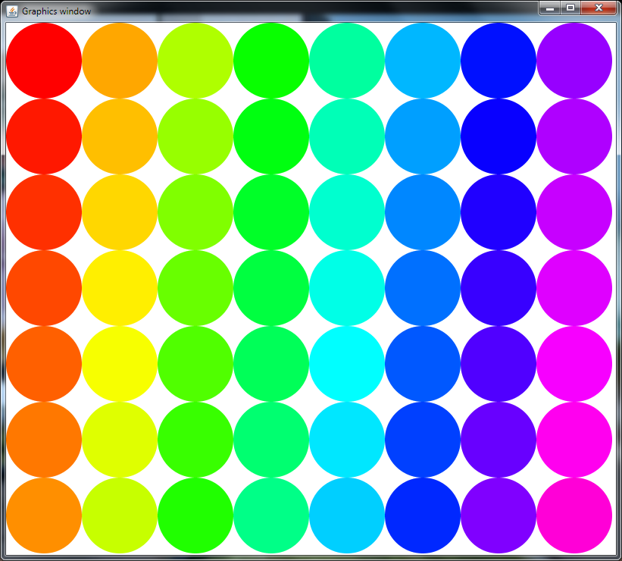
Drawing top to bottom, left to right
Hue starts as 0 (red) and gradually approaches 1 (pink)
Because y varies in the inner loop, it changes every time we draw a circle; when x changes, y resets to 0
float hue = 0;
for (int x = 0; x + 100 < width;
x = x + 100) {
for (int y = 0; y + 100 < height;
y = y + 100) {
g.setColor(Color.getHSBColor(hue,1,1));
g.fillOval(x, y, 100, 100);
hue = hue + 1.0f/64; // increase hue
}
}

Slide 10
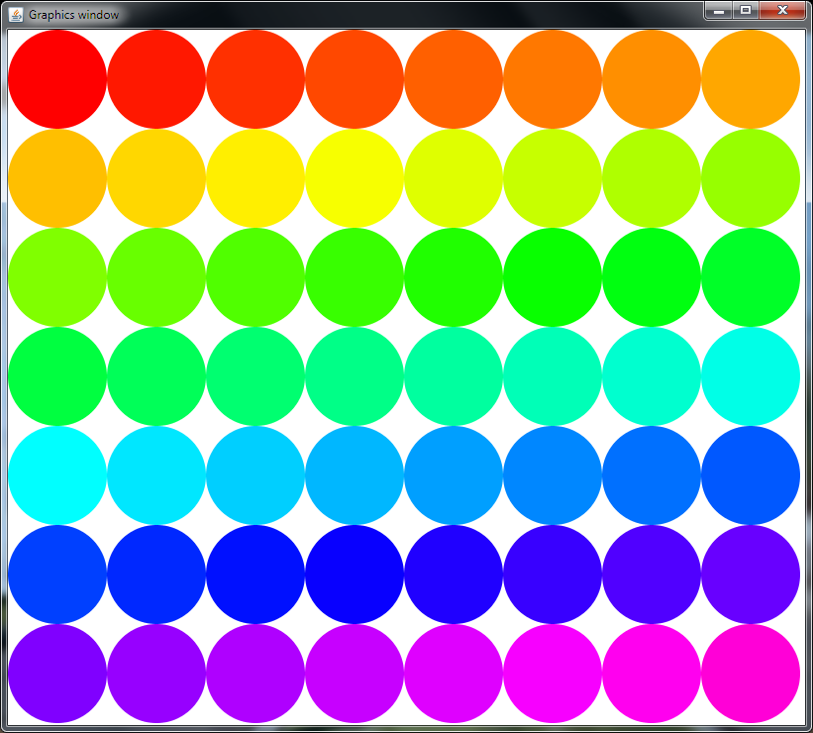
Drawing left to right, top to bottom
By switching the two loops, we change the order in which we draw the circles!
float hue = 0;
for (int y = 0; y + 100 < height; y = y + 100) {
for (int x = 0; x + 100 < width; x = x + 100) {
g.setColor(Color.getHSBColor(hue, 1, 1));
g.fillOval(x, y, 100, 100);
hue = hue + 1.0f/64;
}
}

Slide 11
break statement
If the break statement is executed in a loop, execution resumes immediately after the (inner) loop. Just write: break;
Considering the following while loop:
while (condition>) {
<statements>
} // more statements follow
It is equivalent to the following:
while (true) {
if (!<condition>) break;
<statements>
} // more statements follow

Slide 12
Example: Drawing a triangle of circles
We can draw circles in a triangular formation by stopping drawing circles early
We can come up with a condition to decide when to stop drawing circles

